Slide 1
Asymptotic Behavior
Algorithm : Design & Analysis
[2]

Slide 2
In the last class…
Goal of the Course
Algorithm: the Concept
Algorithm Analysis: the Contents
Average and Worst-Case Analysis
Lower Bounds and the Complexity of Problems

Slide 3
Asymptotic Behavior
Asymptotic growth rate
The Sets Ο, Ω and Θ
Complexity Class
Another Example: Binary Search
  Binary Search Is Optimal
An Example: Maximum Subsequence Sum
  Improvement of Algorithm
  Comparison of Asymptotic Behavior
Notes:
题意
给出一组由正负整数组成的序列，求出拥有最大和的连续子序列。
For example, for the sequence of values −2, 1, −3, 4, −1, 2, 1, −5, 4; the contiguous subarray with the largest sum is 4, −1, 2, 1, with sum 6.
分析
最暴力的算法是两个循环的O(n^2)次循环，而且每次循环执行O(n)次计算；或者计算时画表O(n^2).进一步要使用分治的思想，可以得到O(n*logn)；更好的方法可以达到O(n)，也可以将它看做分治思想。关键在于数学归纳的证明，编程实现非常简单：假定[0, n-1]的最大连续子串已经求出了，要求[0,n]的最大连续子串。
1.如果[0, n-1]中最大子串不包含最右的数字，则判定原最大子串的和与包含最右点的最大子串(>0) + a[n]的和的大小。取大的那个作为[0, n]的最大子串。
2. [0, n]的包含最右点的最大子串=包含最右点的最大子串(>0) + a[n]。
实际上，算法的核心是维持了两个量的记录，即当前的最大子串，以及当前包含最右点的最大子串。

Slide 4
How to Compare Two Algorithm?
Simplifying the analysis
  assumption that the total number of steps is roughly proportional to the number of basic operations counted (a constant coefficient)
  only the leading term in the formula is considered
  constant coefficient is ignored
Asymptotic growth rate
    large n vs. smaller n

Slide 5
Relative Growth Rate
Ω(g):functions that grow at least as fast as g
Θ(g):functions that grow at the same rate as g
g
Ο(g):functions that grow no faster as g

Slide 6
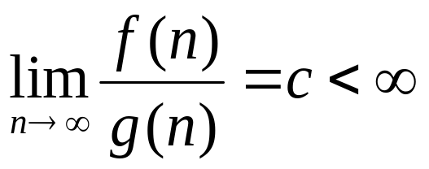
The Set “Big Oh”
Definition
  Giving g:N→R⁺, then Ο(g) is the set of f:N→R⁺, such that for some c∈R⁺ and some n₀∈N, f(n)≤cg(n) for all n≥n₀.
A function f∈Ο(g) if
  Note: c may be zero. In that case, f∈ο(g), “little Oh”
Notes:
g:N→R，定义域是N，因为计算机输入都是离散的规模，
Lim不是必要条件，只是充分条件，有些例子不存在lim值，但还是满足O的定义，比如两个奇偶函数，F（2k）=4k+6，F(2k+1)=3k+4, G（2k）=5k，F(2k+1)=7k+3,则lim值不存在，但是满足大O定义。

Slide 7
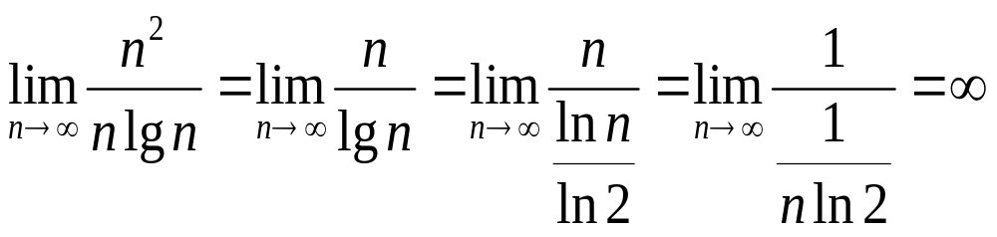
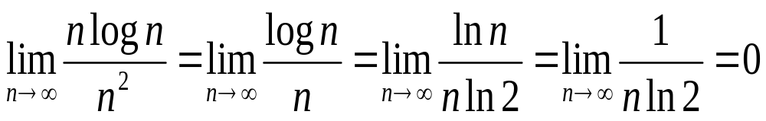

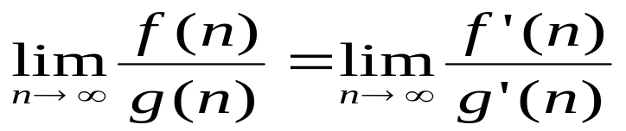
Example
Using L’Hopital’s Rule
Let f(n)=n², g(n)=nlgn, then:
  f∉Ο(g), since
  g∈Ο(f), since
For your reference: L’Hôpital’s rule
with some constraints
Notes:
洛必达法则处理两种类型：
0/0型即分式上面及下面都趋于无穷小
∞/∞型即分式上面及下面都趋于无穷大
算法中只关注后者

Slide 8

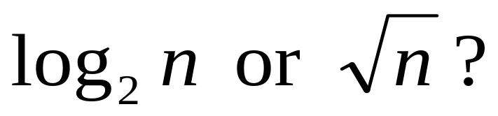
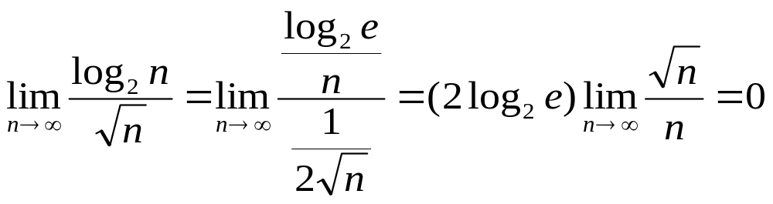
Logarithmic Functions and Powers
Which grows faster?
So, log₂n∈O(√n)

Slide 9
The Result Generalized
The log function grows more slowly than any positive power of n
lgn ∈ o(n^{α}) for any α>0
By the way:
The power of n grows more slowly than any exponential function with base greater than 1
n^{k} ∈ o(c^{n}) for any c>1

Slide 10
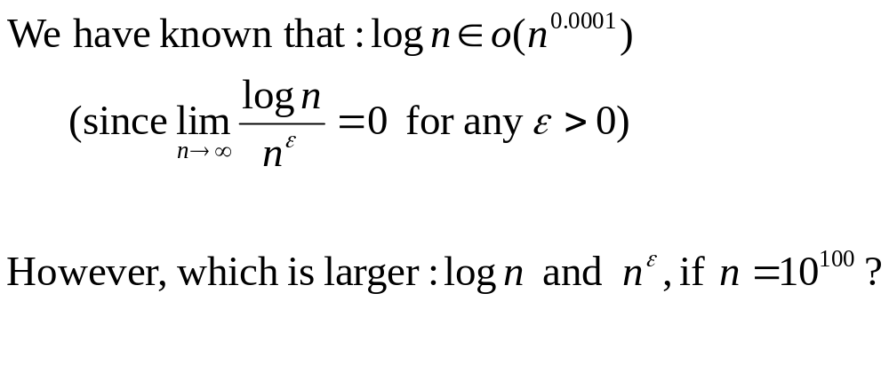
Dealing with big-O correctly

Slide 11
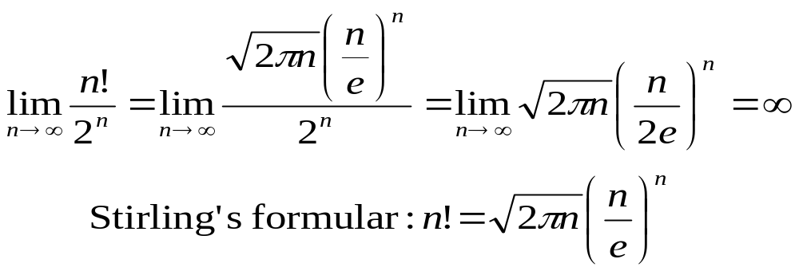
Factorials and Exponential Functions
n! grows faster than 2^{n} for positive integer n.

Slide 12
The Sets Ω and Θ
Definition
  Giving g:N→R⁺, then Ω(g) is the set of f:N→R⁺, such that for some c∈R⁺ and some n₀∈N, f(n)≥cg(n) for all n≥n₀.
A function f∈Ω(g) if lim_{n→∞}[f(n)/g(n)]>0
  Note: the limit may be infinity
Definition
  Giving g:N→R⁺, then Θ(g) = Ο(g) ∩ Ω(g)
A function f∈Θ(g) if lim_{n→∞}[f(n)/g(n)]=c,0<c<∞

Slide 13
Properties of O, Ω and Θ
Transitive property:
  If f∈O(g) and g∈O(h), then f∈O(h)
  If f∈Ω (g) and g∈Ω (h), then f∈Ω (h)
  If f∈Θ (g) and g∈Θ (h), then f∈Θ (h)
Symmetric properties
  f∈O(g) if and only if g∈Ω(f)
  f∈Θ(g) if and only if g∈Θ(f)

Slide 14
Properties of O, Ω and Θ
O(f)+O(g)=O(max(f,g))
g∈O(f), then O(f)+O(g)=O(f)
O(Cf(N))=O(f(N)),C is a positive constant
f∈O(f)

Slide 15
Complexity Class
Let S be a set of f:N→R* under consideration, define the relation ~ on S as following: f~g iff. f∈Θ(g)
then, ~ is an equivalence.
Each set Θ(g) is an equivalence class, called complexity class.
We usually use the simplest element as possible as the representative, so, Θ(n), Θ(n²), etc.

Slide 16
Effect of the Asymptotic Behavior
algorithm
1
2
3
4
Run time in ns
1.3n³
10n²
47nlogn
48n
10³
10⁴
10⁵
10⁶
10⁷
1.3s
22m
15d
41yrs
41mill
10ms
1s
1.7m
2.8hrs
1.7wks
0.4ms
6ms
78ms
0.94s
11s
0.05ms
0.5ms
5ms
48s
0.48s
time for size
max
Size in time
sec
min
hr
day
920
3,600
14,000
41,000
10,000
77,000
6.0×10⁵
2.9×10⁶
1.0×10⁶
4.9×10⁷
2.4×10⁹
5.0×10¹⁰
2.1×10⁷
1.3×10⁹
7.6×10¹⁰
1.8×10¹²
time for 10 times size
×1000
×100
×10+
×10
on 400Mhz Pentium II, in C
from: Jon Bentley: Programming Pearls

Slide 17
Searching an Ordered Array
The Problem: Specification
  Input:
    an array E containing n entries of numeric type sorted in non-decreasing order
    a value K
  Output:
    index for which K=E[index], if K is in E, or, -1, if K is not in E

Slide 18
Sequential Search: the Procedure
The Procedure
  Int seqSearch(int[] E, int n, int K)
  1. Int ans, index;
  2. Ans=-1; // Assume failure
  3. For (index=0; index<n; index++)
  4. If (K= =E[index]) ans=index;//success!
  5. break;
  6. return ans

Slide 19
Sequential Search: the Procedure
The Procedure
  Int seqSearch(int[] E, int n, int K)
  1. Int ans, index;
  2. Ans=-1; // Assume failure
  3. For (index=0; index<n; index++)
  4. If (K= =E[index]) ans=index; //success!
  5. break;
  If (K>E[index]) //fail!
  break;
  6. return ans

Slide 20
Searching a Sequence
For a given K, there are two possibilities
  K in E (say, with probability q), then K may be any one of E[i] (say, with equal probability, that is 1/n)
  K not in E (with probability 1-q), then K may be located in any one of gap(i) (say, with equal probability, that is 1/(n+1))
gap(0)
gap(i-1)
gap(i-1)
E[1]
E[2]
E[i-1]
E[i]
E[I+1]
E[n]

Slide 21
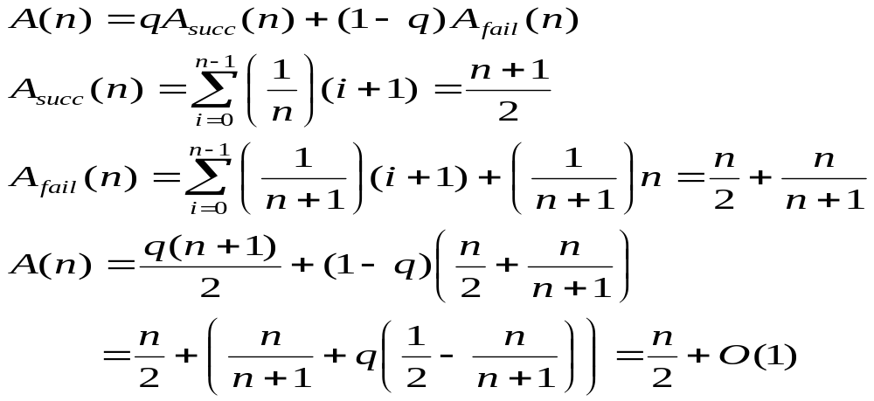
Improved Sequential Search
Since E is sorted, when an entry larger than K is met, no more comparison is needed
  Worst-case complexity: n, unchanged
  Average complexity
  Note: A(n)∈Θ(n)
Roughly n/2

Slide 22
Divide and Conquer
If we compare K to every jth entry, we can locate the small section of E that may contain K.
  To locate a section, roughly n/j steps at most
  To search in a section, j steps at most
  So, the worst-case complexity: (n/j)+j, with j selected properly, (n/j)+j∈Θ(√n)
However, we can use the same strategy in the small sections recursively
Choose j = √n

Slide 23
Binary Search
int binarySearch(int[] E, int first, int last, int K)
  if (last<first)
    index=-1;
  else
    int mid=(first+last)/2
    if (K==E[mid])
      index=mid;
    else if (K<E[mid])
      index=binarySearch(E, first, mid-1, K)
    else if (K>E[mid])
      index=binarySearch(E, mid+1, last, K)
  return index;

Slide 24
Decision Tree
A decision tree for A and a given input of size n is a binary tree whose nodes are labeled with numbers between 0 and n-1
  Root: labeled with the index
  first compared
  If the label on a particular node
  is i, then the left child is labeled
  the index next compared if K<E[i],
  the right child the index next
  compared if K>E[i], and no branch
  for the case of K=E[i].
4
1
7
5
8
0
2
9
3
6

Slide 25
Worst-case Complexity of Binary Search
Observation: with each call of the recursive procedure, only at most half entries left for further consideration.
At most ⎣lg n⎦ calls can be made if we want to keep the range of the section left not less than 1.
So, the worst-case complexity of binary search is ⎣lg n⎦+1=⌈lg(n+1)⌉

Slide 26
Average Complexity of Binary Search
Observation:
  for most cases, the number of comparison is or is very close to that of worst-case
  particularly, if n=2^{k}-1, all failure position need exactly k comparisons
Assumption:
  all success position are equally likely (1/n)
  n=2^{k}-1

Slide 27
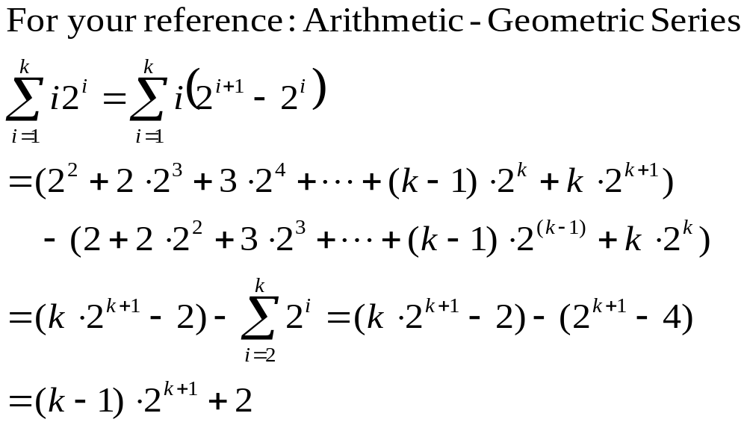
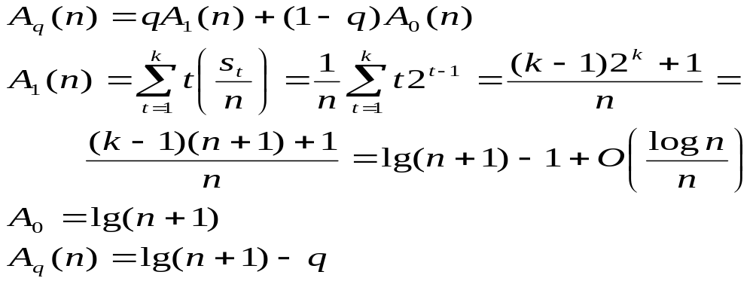
Average Complexity of Binary Search
Average complexity
  Note: We count the sum of s_{t}, which is the number of inputs for which the algorithm does t comparisons, and if n=2^{k}-1, s_{t}=2^{t-1}

Slide 28
Binary Search Is Optimal
If the number of comparison in the worst case is p, then the longest path from root to a leaf is p-1, so there are at most 2^{p}-1 node in the tree.
There are at least n node in the tree.
  (We can prove that For all i∈{0,1,…,n-1}, exist a node with the label i.)
Conclusion: n≤ 2^{p}-1, that is p≥lg(n+1)

Slide 29
Binary Search Is Optimal
For all i∈{0,1,…,n-1}, exist a node with the label i.
Proof:
  if otherwise, suppose that i doesn’t appear in the tree, make up two inputs E₁ and E₂, with E₁[i]=K, E₂[i]=K’, K’>K, for any j≠i, (0≤j≤n-1), E₁[j]=E₂[j]. (Arrange the values to keeping the order in both arrays). Since i doesn’t appear in the tree, for both K and K’, the algorithm behave alike exactly, and give the same outputs, of which at least one is wrong, so A is not a right algorithm.

Slide 30
Home Assignment
pp.63 –
  1.23
  1.27
  1.31
  1.34
  1.37
  1.45

Slide 31


Maximum Subsequence Sum
The problem: Given a sequence S of integer, find the largest sum of a consecutive subsequence of S. (0, if all negative items)
  An example: -2, 11, -4, 13, -5, -2; the result 20: (11, -4, 13)
A brute-force algorithm:
MaxSum = 0;
for (i = 0; i < N; i++)
for (j = i; j < N; j++)
{
ThisSum = 0;
for (k = i; k <= j; k++)
ThisSum += A[k];
if (ThisSum > MaxSum)
MaxSum = ThisSum;
}
return MaxSum;
j=0
the sequence
j=1
j=2
j=n-1
i=0
i=1
k
i=2
……
in O(n³)
i=n-1

Slide 32
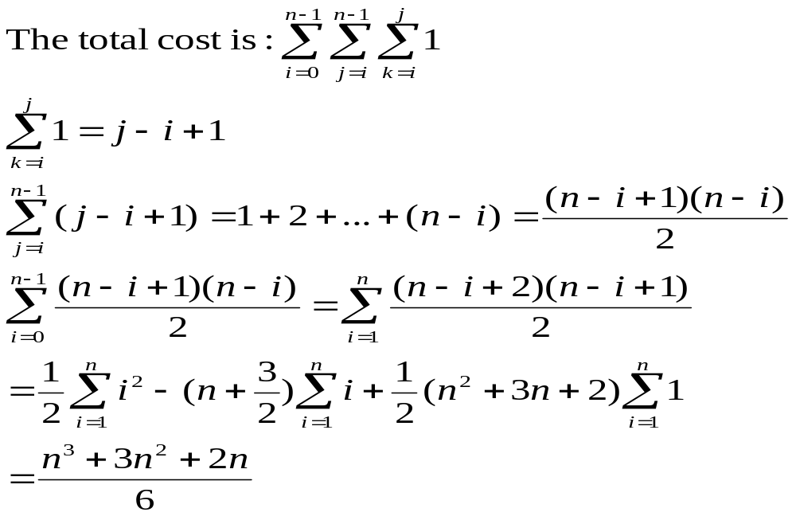
More Precise Complexity

Slide 33
Decreasing the number of loops
An improved algorithm
MaxSum = 0;
for (i = 0; i < N; i++)
{
ThisSum = 0;
for (j = i; j < N; j++)
{
ThisSum += A[j];
if (ThisSum > MaxSum)
MaxSum = ThisSum;
}
}
return MaxSum;
the sequence
i=0
i=1
i=2
j
in O(n²)
i=n-1

Slide 34
Power of Divide-and-Conquer
Part 1
Part 2
the sub with largest sum may be in:
recursion
Part 1
Part 2
or:
The largest is the result
Part 1
Part 2
in O(nlogn)

Slide 35

Divide-and-Conquer: the Procedure
Center = (Left + Right) / 2;
MaxLeftSum = MaxSubSum(A, Left, Center); MaxRightSum = MaxSubSum(A, Center + 1, Right);
MaxLeftBorderSum = 0; LeftBorderSum = 0;
for (i = Center; i >= Left; i--)
{
LeftBorderSum += A[i];
if (LeftBorderSum > MaxLeftBorderSum) MaxLeftBorderSum = LeftBorderSum;
}
MaxRightBorderSum = 0; RightBorderSum = 0;
for (i = Center + 1; i <= Right; i++)
{
RightBorderSum += A[i];
if (RightBorderSum > MaxRightBorderSum) MaxRightBorderSum = RightBorderSum;
}
return Max3(MaxLeftSum, MaxRightSum,
MaxLeftBorderSum + MaxRightBorderSum);
Note: this is the core part of the procedure, with base case and wrap omitted.

Slide 36
A Linear Algorithm
ThisSum = MaxSum = 0;
for (j = 0; j < N; j++)
{
ThisSum += A[j];
if (ThisSum > MaxSum)
MaxSum = ThisSum;
else if (ThisSum < 0)
ThisSum = 0;
}
return MaxSum;
the sequence
j
This is an example of “online algorithm”
Negative item or subsequence cannot be a prefix of the subsequence we want.
in O(n)

